Slide 1
Data Analytics
Hierarchical Clustering
(aka Agglomerative Clustering)
(aka Agglomerative Nesting – AGNES)

Slide 2
Hierarchical Clustering
Produces a set of nested clusters organised as a hierarchical tree
Can be visualised as a dendrogram
A tree like diagram that records the sequences of merges or splits

Slide 3
Strengths of Hierarchical Clustering
Can be used with any distance/proximity matrix
Do not have to assume any particular number of clusters
Any desired number of clusters can be obtained by ‘cutting’ the dendrogram at the proper level
They may correspond to meaningful taxonomies
Example in biological sciences (e.g., animal kingdom, phylogeny reconstruction, …)

Slide 4
How to Define Inter-Cluster Distance
p1
p2
p3
p4
p5
. . .
p1
Similarity?
p2
p3
p4
p5
MIN (Single Linkage)
MAX (Complete Linkage)
Group Average
Distance Between Centroids
Other methods, driven by an objective function
Ward’s Method uses sum of squared errors within clusters
.
.
.
Proximity Matrix

Slide 5
How to Define Inter-Cluster Similarity
p1
p2
p3
p4
p5
. . .
p1
p2
p3
p4
p5
MIN (Single Linkage)
MAX (Complete Linkage)
Group Average
Distance Between Centroids
Other methods, driven by an objective function
Ward’s Method uses sum of squared errors within clusters
.
.
.
Proximity Matrix

Slide 6
How to Define Inter-Cluster Similarity
p1
p2
p3
p4
p5
. . .
p1
p2
p3
p4
p5
MIN (Single Linkage)
MAX (Complete Linkage)
Group Average
Distance Between Centroids
Other methods, driven by an objective function
Ward’s Method uses sum of squared errors within clusters
.
.
.
Proximity Matrix

Slide 7
How to Define Inter-Cluster Similarity
p1
p2
p3
p4
p5
. . .
p1
p2
p3
p4
p5
MIN (Single Linkage)
MAX (Complete Linkage)
Group Average
Distance Between Centroids
Other methods, driven by an objective function
Ward’s Method uses sum of squared errors within clusters
.
.
.
Proximity Matrix

Slide 8
How to Define Inter-Cluster Similarity
p1
p2
p3
p4
p5
. . .
p1
×
×
p2
p3
p4
p5
MIN (Single Linkage)
MAX (Complete Linkage)
Group Average
Distance Between Centroids
Other methods, driven by an objective function
Ward’s Method uses sum of squared errors within clusters
.
.
.
Proximity Matrix

Slide 9
How to Define Inter-Cluster Similarity
p1
p2
p3
p4
p5
. . .
p1
p2
p3
p4
p5
MIN (Single Linkage)
MAX (Complete Linkage)
Group Average
Distance Between Centroids
Other methods, driven by an objective function
Ward’s Method uses sum of squared errors within clusters
.
.
.
Proximity Matrix

Slide 10
Hierarchical Clustering – R
R code
load("VehicleData2018.RData")
summary(Veh2018$Age_of_Driver)
Min. 1st Qu. Median Mean 3rd Qu. Max. NA's
1.00 28.00 38.00 40.89 52.00 101.00 29016
summary(Veh2018$Age_of_Vehicle)
Min. 1st Qu. Median Mean 3rd Qu. Max. NA's
1.00 4.00 8.00 8.12 12.00 84.00 59369
summary(Veh2018$Sex_of_Driver)
Male Female NA's
143361 61233 21815
summary(Veh2018$jct_Location)
Not at or within 20 metres of jct 94416
...
Mid jct - on roundabout or on main road 37237
NA's 7448

Slide 11
Hierarchical Clustering – R
R code
library(cluster) #for daisy function
df<-Veh2018[,c("Age_of_Driver","Age_of_Vehicle",
"Sex_of_Driver","jct_Location")]
df<-df[complete.cases(df),]
#create distance matrix
df.dist<-daisy(df,metric="gower")
Error: cannot allocate vector of size 82.8 Gb
Solution: work with 10% sample of data
set.seed(2021)
df.sample<-df[sample(nrow(df),nrow(df)*0.1),]
df.sample.dist<-daisy(df.sample,metric="gower")

Slide 12
Hierarchical Clustering – R
R code
#hierarchical clustering using Ward's method
ward.D2.out<-hclust(d=df.sample.dist,method="ward.D2")
#show last 10 clustering heights
tail(ward.D2.out$height,10)
[1] 4.975083 5.806869 6.764236 7.116091 9.322801
[6] 10.005390 12.225057 13.190526 17.659163 35.282259
The dendrogram is created from the heights at which cases and clusters are joined together
plot(ward.D2.out)
##add horizontal lines between heights
abline(h=11,lty=2)
abline(h=9.7,lty=2)
abline(h=8,lty=2)

Slide 13
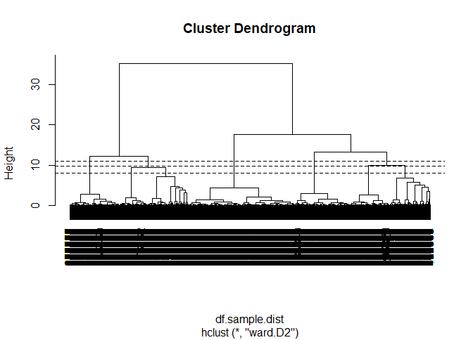
Hierarchical Clustering – R

Slide 14
Hierarchical Clustering – R
How many clusters are there?
The dendrogram shows everything, from each case being a cluster to everything being in just one cluster
Usually we want to identify a relatively small number of clusters
E.g. to target different groups of consumers
Looking at this dendrogram we can see 3 distinct clusters
Trying to cut at 4, 5 or more looks quite marginal

Slide 15
Hierarchical Clustering – R
The NbClust function can carry out hierarchical clustering a number of times and calculate indexes for goodness of clustering
Commonly used indexes are Dunn and Silhouette
However, these only apply an algorithm and ignore requirements that might exist
What makes sense from knowledge of the data?
What range of possible cluster numbers are useful for subsequent work?

Slide 16
Hierarchical Clustering – R
We have used Ward’s Method but this is just one possible choice of method to use when using hierarchical clustering
R code
#hierarchical clustering using min
single.out<-hclust(d=df.sample.dist,method="single")
#hierarchical clustering using max
complete.out<-hclust(d=df.sample.dist,method="complete")
#hierarchical clustering using group average
average.out<-hclust(d=df.sample.dist,method="average")

Slide 17
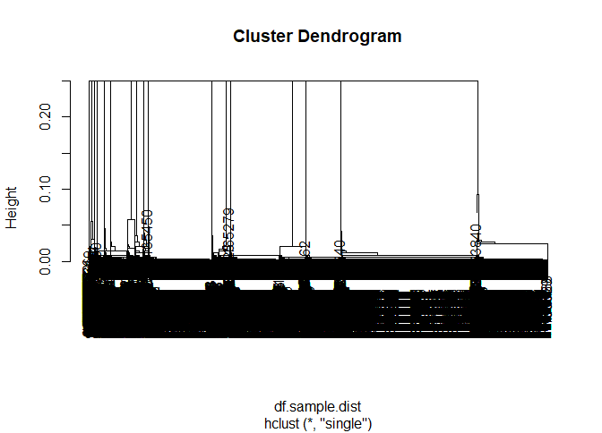
Hierarchical Clustering – R

Slide 18
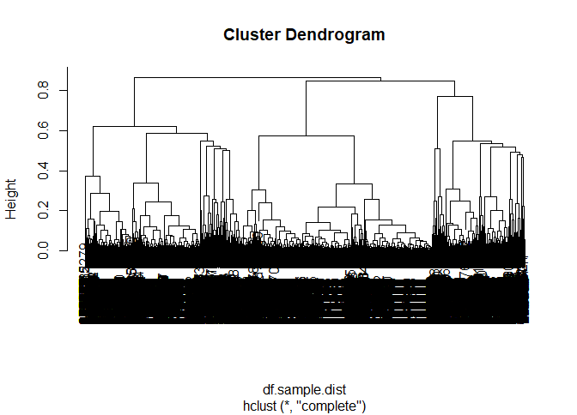
Hierarchical Clustering – R

Slide 19
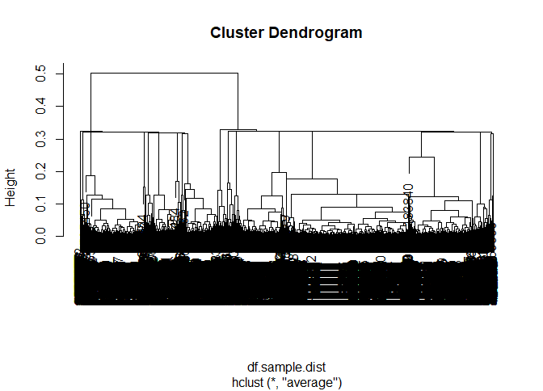
Hierarchical Clustering – R

Slide 20
Hierarchical Clustering – R
Which method is best?
The method which gives the most useful results
This is a subjective decision but here we might go for the three cluster solution from Ward’s method or the four cluster solution from the max/complete method
The min/single and group average methods give results with too many clusters (or too few) to be useful
The following slides show the cluster characteristics for the three cluster solution obtained using Ward’s method

Slide 21
Hierarchical Clustering – R
table(cutree(ward.D2.out,3))
1 2 3
4408 4919 5584
aggregate(df.sample[,1:2], by=list(cluster=cutree(ward.D2.out,3)),mean)
cluster Age_of_Driver Age_of_Vehicle
1 1 41.68829 8.179220
2 2 41.32568 7.953243
3 3 41.61300 8.077901

Slide 22
Hierarchical Clustering – R
aggregate(df.sample[,3], by=list(cluster=cutree(ward.D2.out,3)),table)
cluster x.Male x.Female
1 1 4408 0
2 2 0 4919
3 3 5567 17
table(df.sample$jct_Location,cutree(ward.D2.out,3))
1 2 3
Not at or within 20 metres of jct 4408 2065 0
Approaching jct or waiting/parked at jct approach 0 1157 2300
Cleared jct or waiting/parked at jct exit 0 237 556
Leaving roundabout 0 87 166
Entering roundabout 0 189 271
Leaving main road 0 133 248
Entering main road 0 210 380
Entering from slip road 0 0 55
Mid jct - on roundabout or on main road 0 841 1608

Slide 23
Hierarchical Clustering – R
Exercise
With the same Department for Transport Road Safety Data, undertake a hierarchical cluster analysis using the variables "Age_of_Driver", "Engine_Capacity_.CC.", "Sex_of_Driver“ and "jct_Location"
Adapt code in the file “Hierarchical Clustering - class session code.R”
Decide which number of clusters is best
Create summary statistics

Slide 24
Hierarchical Clustering: Problems
Hierarchical clustering is “expensive” in terms of the time and space required
o(N²) space since it uses the proximity matrix.
N is the number of points.
o(N³) time in many cases
There are N steps and at each step the size, N², proximity matrix must be updated and searched
Complexity can be reduced to O(N² log(N) ) time with some cleverness

